Slide 1
What is SharePoint PnP PowerShell for SharePoint Online
Speaker Name

Slide 3
Objective
After completing this lesson, you will be able to:
Identify where to obtain the SharePoint PnP PowerShell module for SharePoint Online
Understand how to set up the SharePoint PnP PowerShell module for SharePoint Online environment and connect to a SharePoint Online site
Describe how to use the SharePoint PnP PowerShell module for SharePoint Online to create a new list and field objects within a site

Slide 4
SharePoint PnP PowerShell Cmdlets for SharePoint Online

Slide 5
Patterns and Practices (PnP) PowerShell Cmdlets
SharePoint PnP PowerShell Cmdlets are an open source solution available on GitHub
GitHub is one of the largest open source communities in the world
The SharePoint PnP PowerShell cmdlets are based on the Client Side Object Module (CSOM)
It is a package of SharePoint Online PowerShell cmdlets for working with Lists, List Items, complex provisioning and artifact management actions towards SharePoint
New PnP PowerShell cmdlets are added and released monthly
The latest documentation can be found at: https://docs.microsoft.com/en-us/powershell/sharepoint/sharepoint-pnp/sharepoint-pnp-cmdlets?view=sharepoint-ps

Slide 6
Getting the Latest Release of PnP PowerShell for O365 SharePoint Online
Sharepoint PnP PowerShell for SharePoint Online is released every month, and the latest releases can be found at the following url: https://github.com/SharePoint/pnp-powershell/releases
SharePointPnPPowerShellOnline.msi is for SharePoint Online

Slide 7
Getting Started
On Windows 10, or if you have PowerShellGet installed, run the following to install the Windows PowerShell cmdlets:
From within PowerShell ISE run:
Install-Module SharePointPnPPowerShellOnline
Get-Module SharePointPnPPowerShell* -ListAvailable | Select-Object Name,Version | Sort-Object Version –Descending

Slide 8
PnP PowerShell Cmdlets
As new releases of the module become available, you can run the following cmdlet to install the latest updated version:
Update-Module SharePointPnPPowerShellOnline
To use the library, you first need to connect to a PnP site :
Connect-PnPOnline –Url https://<tenantname>.sharepoint.com –UseWebLogin
This command is compatibible with MFA
To view all cmdlets, use:
Get-command -module SharePointPnPPowerShellOnline

Slide 9
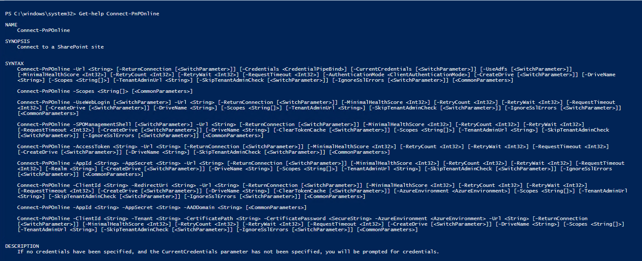
Get-Help
SYNTAX: Get-Help <PnPOnline Cmdlt> -Detailed
Example: Get-Help Connect-PnPOnline -Detailed
Notes:
The Syntax or examples can be customized too as this is Open Source.
To get help on a cmdlet:
SYNTAX: Get-Help <PnP Pnp Cmdlt> -Detailed
Example: Get-Help Connect-Pnpnline –Detailed

Slide 10
Commonly used Base PnP PowerShell Cmdlets
Cmdlet | Description
Add-PnPField | Add a field to a list or library
Get‑PnPField | Gets fields from site, list or library
Import-PnPTaxonomy | Imports a taxonomy from either a string array or a file
New-PnPPersonalSite | Creates a personal / OneDrive For Business site
Connect‑PnpOnline | Connects to a SharePoint site and creates an in-memory context
Get‑PnPSite | Returns the current site collection from the context
Set-PnPHomeSite | Sets the home site for your tenant
Add-PnPSiteDesign | Creates a new site design on the current tenant
Add-PnPSiteScript | Creates a new Site Script on the current tenant

Slide 11
List Management PnP Cmdlets
Cmdlet | Description
Get‑PnPList | Returns a List object.
New‑PnPList | Creates a new list.
Remove‑PnPList | Deletes a list.
Set‑PnPList | Updates list settings.
Add‑PnPListItem | Adds an item to a list.
Get‑PnPListItem | Retrieves list items.
Remove‑PnPListItem | Deletes an item from a list.
Set‑PnPListItem | Updates a list item.
Set‑PnPListItemPermission | Sets list item permissions.
Move‑PnPListItemToRecycleBin | Moves an item from a list to the Recycle Bin.

Slide 12
File Management PnP Cmdlets
Cmdlet | Description
Add‑PnPFile | Uploads a file to Web
Copy‑PnPFile | Copies a file or folder to a different location
Find‑PnPFile | Finds a file in the virtual file system of the web.
Get‑PnPFile | Downloads a file.
Move‑PnPFile | Moves a file to a different location
Remove‑PnPFile | Removes a file.
Rename‑PnPFile | Renames a file in its current location
Set‑PnPFileCheckedIn | Checks in a file
Set‑PnPFileCheckedOut | Checks out a file

Slide 13
Folder Management PnP Cmdlets
Cmdlet | Description
Add‑PnPFolder | Creates a folder within a parent folder
Get‑PnPFolder | Return a folder object
Move‑PnPFolder | Move a folder to another location in the current web
Remove‑PnPFolder | Deletes a folder within a parent folder
Rename‑PnPFolder | Renames a folder
Resolve‑PnPFolder | Returns a folder from a given site relative path, and will create it if it does not exist.
Get‑PnPFolderItem | List content in folder
Copy‑PnPItemProxy | Proxy cmdlet for using Copy-Item between SharePoint provider and FileSystem provider
Move‑PnPItemProxy | Proxy cmdlet for using Move-Item between SharePoint provider and FileSystem provider

Slide 14
Retention and Information Rights Management PnP Cmdlets
Cmdlet | Description
Get‑PnPLabel | Gets the label/tag of the specified list or library (if applicable)
Set‑PnPLabel | Sets a label/tag on the specified list or library
Get‑PnPListInformationRightsManagement | Get the site closure status of the site which has a site policy applied
Set‑PnPListInformationRightsManagement | Get the site closure status of the site which has a site policy applied
Get‑PnPSiteClosure | Get the site closure status of the site which has a site policy applied
Set‑PnPSiteClosure | Opens or closes a site which has a site policy applied
Set‑PnPSitePolicy | Sets a site policy
Get‑PnPSitePolicy | Retrieves all or a specific site policy

Slide 15
Content Type PnP Cmdlets
Cmdlet | Description
Add‑PnPContentType | Adds a new content type
Get‑PnPContentType | Retrieves a content type
Remove‑PnPContentType | Removes a content type from a web
Remove‑PnPContentTypeFromList | Removes a content type from a list
Get‑PnPContentTypePublishingHubUrl | Returns the url to Content Type Publishing Hub
Add‑PnPContentTypeToList | Adds a new content type to a list
Set‑PnPDefaultContentTypeToList | Sets the default content type for a list
Remove‑PnPFieldFromContentType | Removes a site column from a content type

Slide 16
Creating list using traditional PowerShell method
Add-Type -Path 'C:\Program Files\Common Files\Microsoft Shared\Web Server Extensions\16\ISAPI\Microsoft.SharePoint.Client.dll'
Add-Type –Path 'C:\Program Files\Common Files\Microsoft Shared\Web Server Extensions\16\ISAPI\Microsoft.SharePoint.Client.Runtime.dll'
$url="https://<YourSite>.sharepoint.com/"
$creds=Get-Credential -Message “Add Your Credentials"
$O365Credential=new-objectMicrosoft.SharePoint.Client.SharePointOnlineCredentials
($creds.UserName,$creds.Password)
$ctx=new-objectMicrosoft.SharePoint.Client.ClientContext($url)
$ctx.Credentials=$O365Credential
$ListCreationInfo=new-objectMicrosoft.SharePoint.Client.ListCreationInformation;
$ListCreationInfo.Title="Demo Location List";
$ListCreationInfo.TemplateType=[Microsoft.SharePoint.Client.ListTemplateType]::GenericList;
$ListCreationInfo.Url="lists/demo";
$list=$ctx.Web.lists.Add($ListCreationInfo);
# Add the field
$fieldXml="<Field Type=""Choice"" Name=""SPSLocation"" DisplayName=""Location"" ID=""{cb27f512-37bc-4d07-bdd4-2ee61bc5bac3}"" Group=""Demo Group"“ Required=""TRUE""><CHOICES><CHOICE>New Delhi</CHOICE><CHOICE>Seattle</CHOICE><CHOICE>Shanghai</CHOICE></CHOICES></Field>"
$field=$list.Fields.AddFieldAsXml($fieldXml,$true,[Microsoft.SharePoint.Client.AddFieldOptions]::AddFieldToDefaultView);
$ctx.Load($list);
$ctx.ExecuteQuery();

Slide 17
New PnP way to create a list
Connect-PnPOnline -Url https://<YourSite>.sharepoint.com/ -UseWebLogin
New-PnPList -Title "Demo Location List" -Template GenericList -Url lists/demo
Add-PnPField -List "Demo Location List" -DisplayName "Location" -InternalName "SPSLocation" -Type Choice -Group "Demo Group" -AddTo DefaultView -Choices "New Delhi","Seattle","Shanghai"

Slide 18
Knowledge Check
On Windows 10, or if you have PowerShellGet installed, what command do you run to install the PnP PowerShell module for SharePoint Online?
What PnP command must you run in order to connect to your SharePoint Online tenant or Site Collection?
What PnP cmdlet would you run if you want to add a fields to a list in SharePoint Online?
Install-Module SharePointPnPPowerShellOnline
Connect-PnPOnline –Url https://yoursite.sharepoint.com –UseWebLogin
Add-PnPField

Slide 19
Summary
In this lesson, you learned:
What is the SharePoint Online Management Shell and where to get it
How to set up the SharePoint Online Management Shell environment and connect to the SharePoint Online service
How the SharePoint Online Windows PowerShell module can be used to manage a SharePoint Online tenant

Slide 20
Lab
Using the PnP PowerShell module for SharePoint Online
Notes:
Introduction
In this lab, you will utilize the SharePoint Online Management Shell to manage and configure key objects within a SharePoint Online environment. You will also use the SharePoint Online Management Shell to automate common SharePoint Online administrative tasks, such as creating site collections in bulk and pulling site collection version information.
Objectives
After completing this lab, you will be able to:
Connect the SharePoint Online Management Shell to an Microsoft 365 SharePoint Online tenant.
Use the SharePoint Online Management Shell to perform various SharePoint Online configuration and management functions.
Prerequisites
This lab requires that students have their own Wave 15 Microsoft 365 trial tenant. If you do not already have a Wave 15 Microsoft 365 trial tenant, you can obtain one by going to the following web page and following the instructions on the page: https://portal.microsoftonline.com/Signup/MainSignup15.aspx?OfferId=D214930B-46C2-4FD2-B7F9-EC134993F34A&dl=ENTERPRISEPACK_B_PILOT&pc=O365-Preview-2012&ali=1
Estimated Time to Complete This Lab
45 minutes

